Slide 1
SINGULAR VALUE DECOMPOSITION
Kaushal Khatiwada
Roll No 13

Slide 2
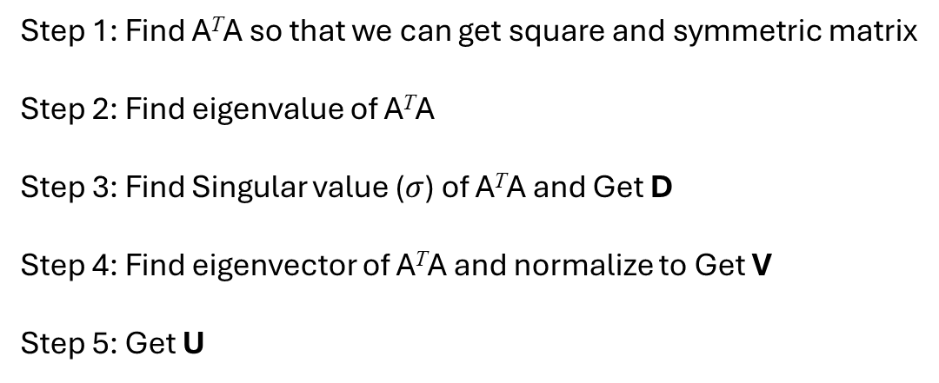
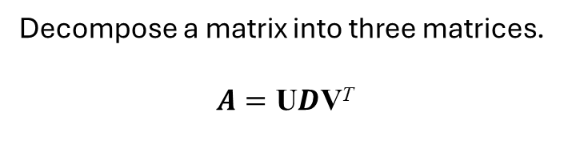
Decompose a matrix into three matrices.
$$A=\text{U}D\text{V}\text{T}$$
Determine the matrices U, D and V such that A = UDV^{T} for the matrix A = $\left(\begin{matrix}1 & 0 \\ 0 & 1 \\ 1 & 2\end{matrix}\right)$ .
Step 1: Find A^{T}A so that we can get square and symmetric matrix
Step 2: Find eigenvalue of A^{T}A
Step 3: Find Singular value ($σ$) of A^{T}A and Get D
Step 4: Find eigenvector of A^{T}A and normalize to Get V
Step 5: Get U

Slide 3
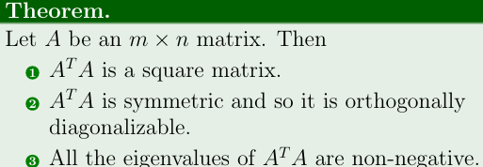
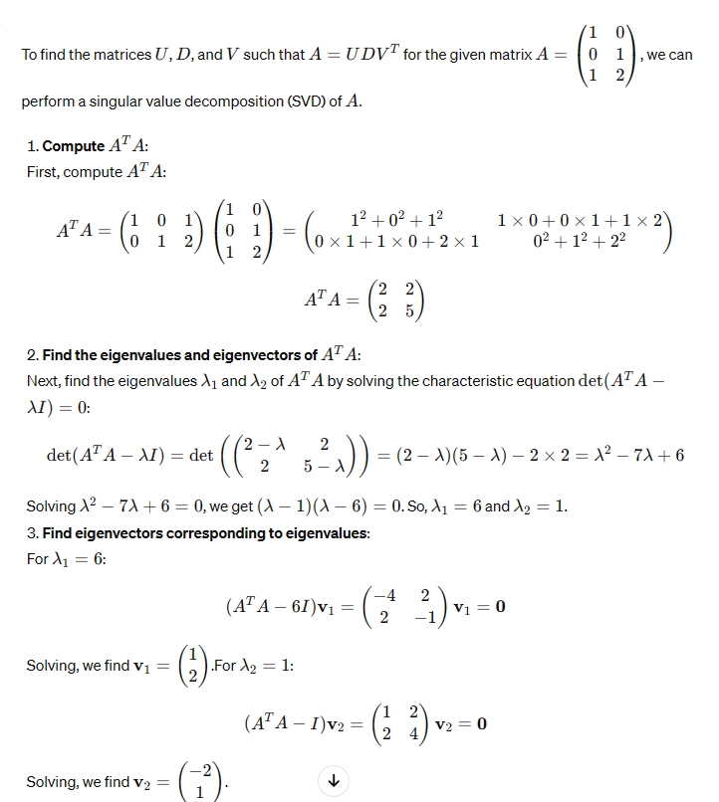

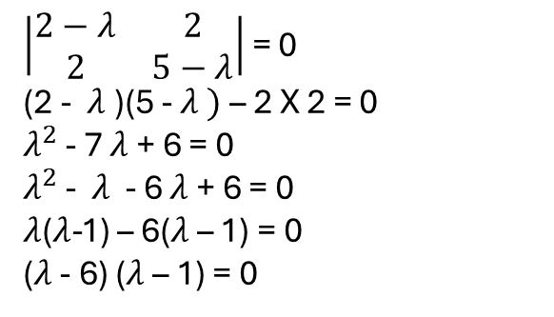


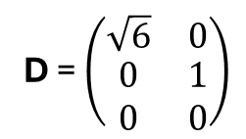

Given, A is the rectangular matrix
1) Find A^{T}A .
2) Find eigenvalue of A^{T}A
3) Find Singular value ($σ$) of A^{T}A and Get D
| A^{T}A - $λ I |=0$
Singular value is the square root of eigen value
$\left|\begin{matrix}2−λ & 2 \\ 2 & 5−λ\end{matrix}\right|$ = 0
(2 - $λ$)(5 - $λ )$– 2 X 2 = 0
$λ^{2}$ - 7 $λ$ + 6 = 0
$λ^{2}$ - $λ$ - 6 $λ$ + 6 = 0
$λ$($λ$-1) – 6($λ$ – 1) = 0
($λ$ - 6) ($λ$ – 1) = 0
$σ_{1 }$= $\sqrt{λ_{1 }}$ = $\sqrt{6}$
D = $\left(\begin{matrix}\sqrt{6} & 0 \\ \begin{aligned}0 \\ 0\end{aligned} & \begin{aligned}1 \\ 0\end{aligned}\end{matrix}\right)$
$σ_{2 }$= $\sqrt{λ_{2 }}$ = $\sqrt{1}$ = 1
Order of matrix D must be same as Order of matrix A so, new row is added
So, eigenvalue of A^{T}A are $λ_{1 }$= 6 and $λ_{2 }$= 1

Slide 4
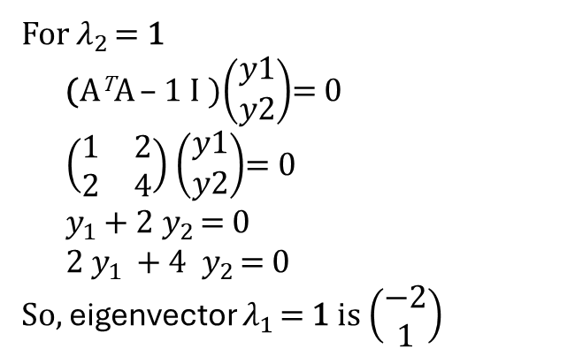
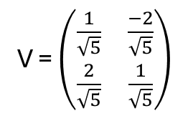
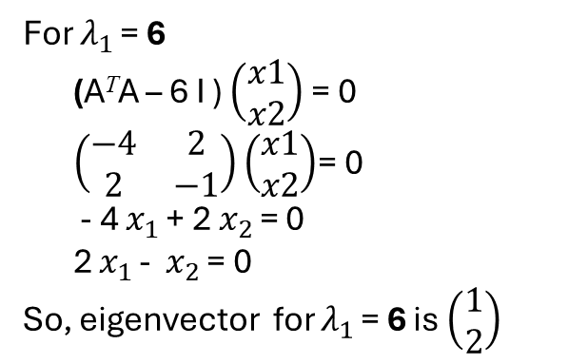
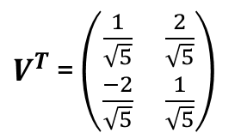
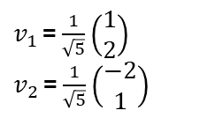

4) Find eigenvector of A^{T}A and normalize to Get V
For $λ_{1 }$= 6
(A^{T}A – 6 I ) $\left(\begin{aligned}x1 \\ x2\end{aligned}\right)$= 0
$\left(\begin{matrix}−4 & 2 \\ 2 & −1\end{matrix}\right)$ $\left(\begin{aligned}x1 \\ x2\end{aligned}\right)$= 0
- 4 $x_{1 }$+ 2 $x_{2 }$= 0
2 $x_{1 }$- $x_{2 }$= 0
So, eigenvector for $λ_{1 }$= 6 is $\left(\begin{aligned}1 \\ 2\end{aligned}\right)$
For $λ_{2 }$= 1
(A^{T}A – 1 I )$\left(\begin{aligned}y1 \\ y2\end{aligned}\right)$= 0
$\left(\begin{matrix}1 & 2 \\ 2 & 4\end{matrix}\right)$ $\left(\begin{aligned}y1 \\ y2\end{aligned}\right)$= 0
$y_{1 }$+ 2 $y_{2 }$= 0
2 $y_{1 }+4$ $y_{2 }$= 0
So, eigenvector $λ_{1 }$= 1 is $\left(\begin{aligned}−2 \\ 1\end{aligned}\right)$
Normalize: $\frac{a}{|\left|a\right||}$
$v_{1 }$= $\frac{1}{\sqrt{5}}$ $\left(\begin{aligned}1 \\ 2\end{aligned}\right)$
$v_{2 }$= $\frac{1}{\sqrt{5}}$ $\left(\begin{aligned}−2 \\ 1\end{aligned}\right)$
V = $\left(\begin{matrix}\frac{1}{\sqrt{5}} & \frac{−2}{\sqrt{5}} \\ \frac{2}{\sqrt{5}} & \frac{1}{\sqrt{5}}\end{matrix}\right)$
$V^{T}$ = $\left(\begin{matrix}\frac{1}{\sqrt{5}} & \frac{2}{\sqrt{5}} \\ \frac{−2}{\sqrt{5}} & \frac{1}{\sqrt{5}}\end{matrix}\right)$

Slide 5
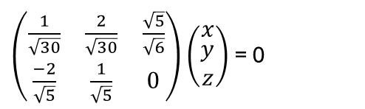
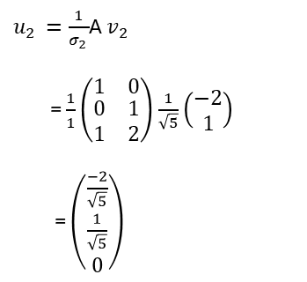

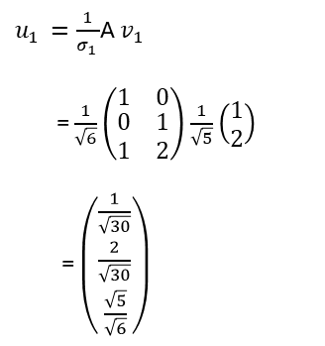
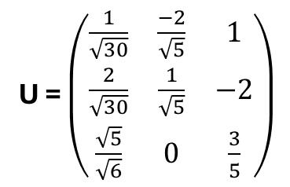


5) Get U
$u_{1 }=\frac{1}{σ_{1 }}$A $v_{1 }$
= $\frac{1}{\sqrt{6}}$ $\left(\begin{matrix}1 & 0 \\ \begin{aligned}0 \\ 1\end{aligned} & \begin{aligned}1 \\ 2\end{aligned}\end{matrix}\right)$ $\frac{1}{\sqrt{5}}$ $\left(\begin{aligned}1 \\ 2\end{aligned}\right)$
= $\left(\begin{aligned}\frac{1}{\sqrt{30}} \\ \begin{aligned}\frac{2}{\sqrt{30}} \\ \frac{\sqrt{5}}{\sqrt{6}}\end{aligned}\end{aligned}\right)$
$u_{2 }=\frac{1}{σ_{2 }}$A $v_{2 }$
= $\frac{1}{1}$ $\left(\begin{matrix}1 & 0 \\ \begin{aligned}0 \\ 1\end{aligned} & \begin{aligned}1 \\ 2\end{aligned}\end{matrix}\right)$ $\frac{1}{\sqrt{5}}$ $\left(\begin{aligned}−2 \\ 1\end{aligned}\right)$
= $\left(\begin{aligned}\frac{−2}{\sqrt{5}} \\ \begin{aligned}\frac{1}{\sqrt{5}} \\ 0\end{aligned}\end{aligned}\right)$
Since, U is orthogonal matrix. So, $u_{3}$ is perpendicular to $u_{1} and{ u}_{2 }$.
$u_{1}$. $u_{3 }$ = 0
$\left(\begin{aligned}\frac{1}{\sqrt{30}} \\ \begin{aligned}\frac{2}{\sqrt{30}} \\ \frac{\sqrt{5}}{\sqrt{6}}\end{aligned}\end{aligned}\right)$ . $\left(\begin{aligned}x \\ \begin{aligned}y \\ z\end{aligned}\end{aligned}\right)$ = 0
$u_{2}$. $u_{3 }$ = 0
$\left(\begin{aligned}\frac{−2}{\sqrt{5}} \\ \begin{aligned}\frac{1}{\sqrt{5}} \\ 0\end{aligned}\end{aligned}\right)$ . $\left(\begin{aligned}x \\ \begin{aligned}y \\ z\end{aligned}\end{aligned}\right)$ = 0
U = $\left(\begin{matrix}\frac{1}{\sqrt{30}} & \frac{−2}{\sqrt{5}} & 1 \\ \frac{2}{\sqrt{30}} & \frac{1}{\sqrt{5}} & −2 \\ \frac{\sqrt{5}}{\sqrt{6}} & 0 & \frac{3}{5}\end{matrix}\right)$
$\left(\begin{matrix}\frac{1}{\sqrt{30}} & \frac{2}{\sqrt{30}} & \frac{\sqrt{5}}{\sqrt{6}} \\ \frac{−2}{\sqrt{5}} & \frac{1}{\sqrt{5}} & 0\end{matrix}\right)$ $\left(\begin{aligned}x \\ \begin{aligned}y \\ z\end{aligned}\end{aligned}\right)$ = 0
$$u_{3 = } \left(\begin{aligned}1 \\ \begin{aligned}−2 \\ \frac{3}{5}\end{aligned}\end{aligned}\right)$$
Solving the equation. We get,

Slide 6
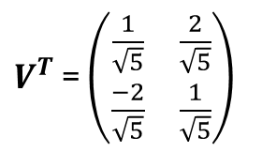
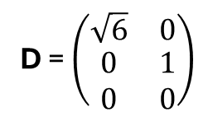
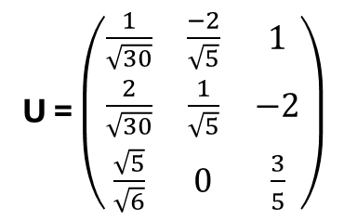
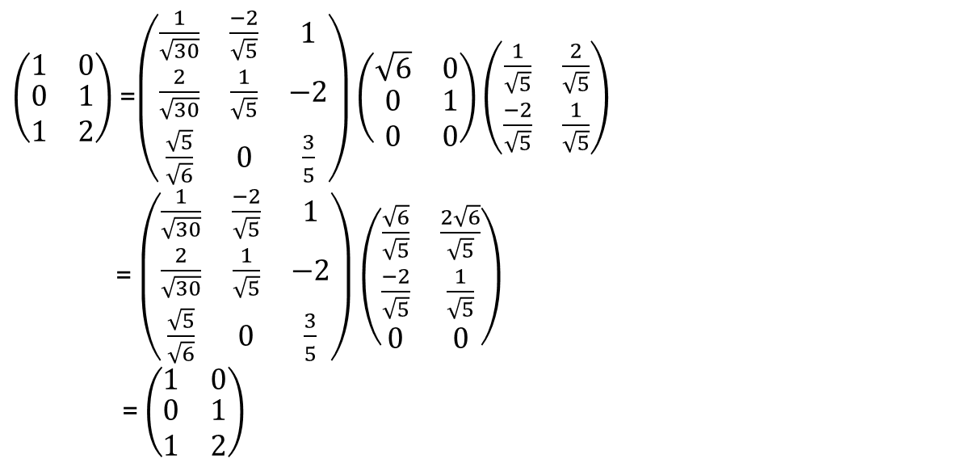
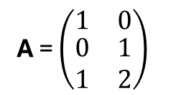
U = $\left(\begin{matrix}\frac{1}{\sqrt{30}} & \frac{−2}{\sqrt{5}} & 1 \\ \frac{2}{\sqrt{30}} & \frac{1}{\sqrt{5}} & −2 \\ \frac{\sqrt{5}}{\sqrt{6}} & 0 & \frac{3}{5}\end{matrix}\right)$
A = $\left(\begin{matrix}1 & 0 \\ \begin{aligned}0 \\ 1\end{aligned} & \begin{aligned}1 \\ 2\end{aligned}\end{matrix}\right)$
D = $\left(\begin{matrix}\sqrt{6} & 0 \\ \begin{aligned}0 \\ 0\end{aligned} & \begin{aligned}1 \\ 0\end{aligned}\end{matrix}\right)$
$V^{T}$ = $\left(\begin{matrix}\frac{1}{\sqrt{5}} & \frac{2}{\sqrt{5}} \\ \frac{−2}{\sqrt{5}} & \frac{1}{\sqrt{5}}\end{matrix}\right)$
For verification
A = UDV^{T}
$\left(\begin{matrix}1 & 0 \\ \begin{aligned}0 \\ 1\end{aligned} & \begin{aligned}1 \\ 2\end{aligned}\end{matrix}\right)$ =$\left(\begin{matrix}\frac{1}{\sqrt{30}} & \frac{−2}{\sqrt{5}} & 1 \\ \frac{2}{\sqrt{30}} & \frac{1}{\sqrt{5}} & −2 \\ \frac{\sqrt{5}}{\sqrt{6}} & 0 & \frac{3}{5}\end{matrix}\right)\left(\begin{matrix}\sqrt{6} & 0 \\ \begin{aligned}0 \\ 0\end{aligned} & \begin{aligned}1 \\ 0\end{aligned}\end{matrix}\right)$ $\left(\begin{matrix}\frac{1}{\sqrt{5}} & \frac{2}{\sqrt{5}} \\ \frac{−2}{\sqrt{5}} & \frac{1}{\sqrt{5}}\end{matrix}\right)$
= $\left(\begin{matrix}\frac{1}{\sqrt{30}} & \frac{−2}{\sqrt{5}} & 1 \\ \frac{2}{\sqrt{30}} & \frac{1}{\sqrt{5}} & −2 \\ \frac{\sqrt{5}}{\sqrt{6}} & 0 & \frac{3}{5}\end{matrix}\right)\left(\begin{matrix}\frac{\sqrt{6}}{\sqrt{5}} & \frac{2\sqrt{6}}{\sqrt{5}} \\ \begin{aligned}\frac{−2}{\sqrt{5}} \\ 0\end{aligned} & \begin{aligned}\frac{1}{\sqrt{5}} \\ 0\end{aligned}\end{matrix}\right)$
= $\left(\begin{matrix}1 & 0 \\ \begin{aligned}0 \\ 1\end{aligned} & \begin{aligned}1 \\ 2\end{aligned}\end{matrix}\right)$

